Slide 1
Thinking of and with data: How students and teachers (and researchers) use data in STEM education
Joshua M. Rosenberg, Doctoral Candidate
Michigan State University
January 24th, 2018
University of Tennessee, Knoxville
Department of Theory and Practice of Teacher Education
Notes:
Work with data
Also implications
Mention NGSS
Make a slide
Thank you to the Mehmet Aydeniz and the search committee and the faculty and students in the TPTE department as well as Ms. Gina Guinn for making this trip possible.
This talk is on thinking of and with data in STEM.
In particular, this talk is focused on the affordances of new sources of data for teachers and students.
And, is on how new sources of data can help us understand teaching and learning in STEM.
Work with data can help students (and teachers) across STEM classrooms to go beyond “doing school” to engage in disciplinary practices, such as analyzing and interpreting data and developing and using models. Using authentic sources of data in classroom contexts can be challenging because of the time and planning such work takes as well as how it differs from how students have traditionally worked with data at school. In this talk, I describe research on how students engage with authentic sources of data in science classrooms and summer STEM enrichment programs. Also, I show how researchers can use a variety of data sources and methods to understand student engagement with data and other science and STEM activities. I discuss implications for teachers, teacher educators and professional development providers, and for the design of educational technologies. Finally, I outline some future directions for uses of data across STEM disciplines.

Slide 2
Introduction | Overview | Study 1 | Study 2 | Future Work
Introduction
Overview
Study 1
Study 2
Future Work

Slide 3
Research interest
Introduction | Overview | Study 1 | Study 2 | Future Work
Role and use of data in K-12 STEM research, teaching, and learning
Taught H.S. Biology, Chemistry, and Earth Science
Motivated by challenges and opportunities from helping students do science in personally meaningful ways
Apply research to teaching about technology integration in science education, especially on teachers’ Technological Pedagogical Content Knowledge (TPACK)
Notes:
why you went to grad school

Slide 4
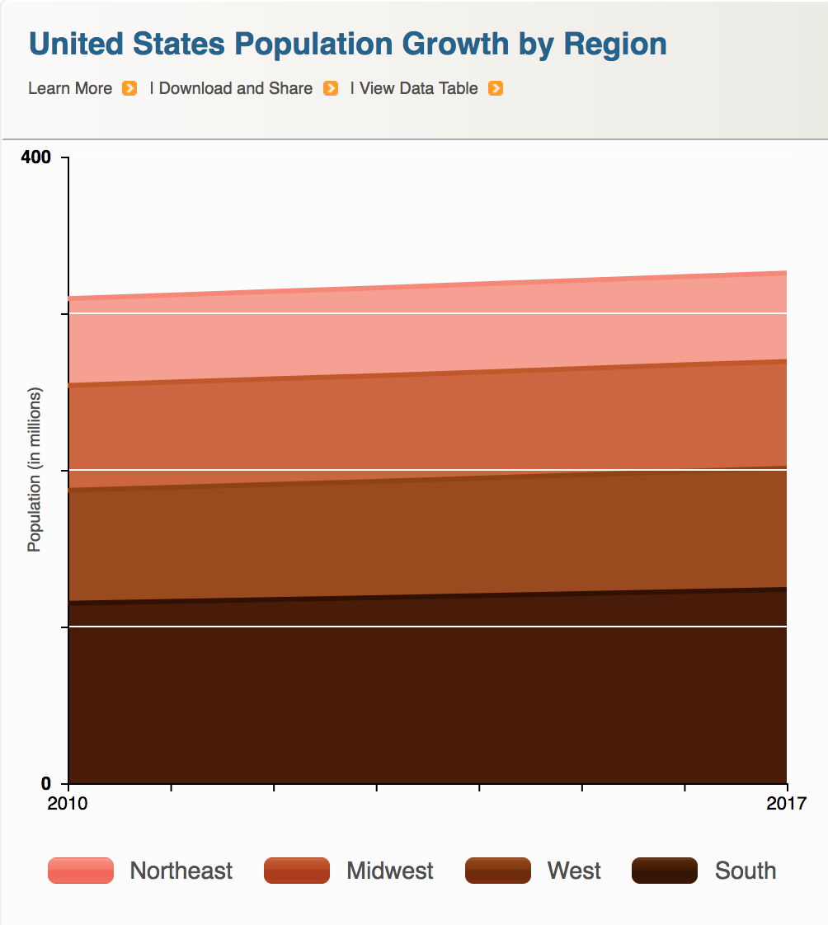
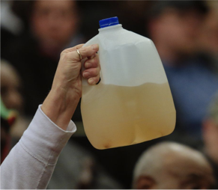

Data is power(ful)
Introduction | Overview | Study 1 | Study 2 | Future Work
Companies
Government
Citizens

Slide 5
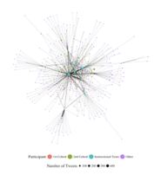
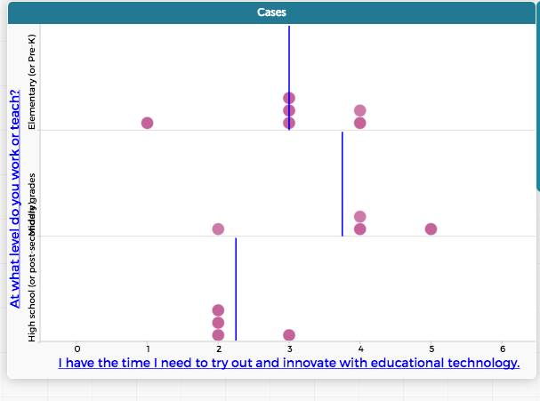
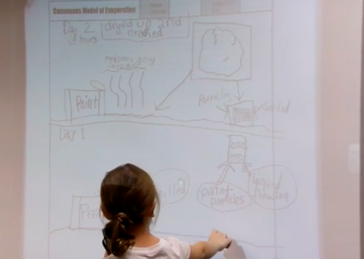
Data is power(ful)
Introduction | Overview | Study 1 | Study 2 | Future Work
Researchers
Teachers
Students
Notes:
talking about agency

Slide 6
Research focused on work with data
Introduction | Overview | Study 1 | Study 2 | Future Work
Students’ Work With Data
Teachers’ Support for Work With Data
Notes:
As you can see, I have a lot of questions and interests about the use of data in science education research, teaching, and learning. I obviously can’t talk about all of these questions today, but I will,
Touch on some of them briefly,
And later, I’ll go into some considerable depth on one of them.

Slide 7
Research focused on work with data
Introduction | Overview | Study 1 | Study 2 | Future Work
Students’ Work With Data
Teachers’ Support for Work With Data
Curricular standards,
resources,
assessments,
and technological tools
Notes:
As you can see, I have a lot of questions and interests about the use of data in science education research, teaching, and learning. I obviously can’t talk about all of these questions today, but I will,
Touch on some of them briefly,
And later, I’ll go into some considerable depth on one of them.

Slide 8
Research focused on work with data
Introduction | Overview | Study 1 | Study 2 | Future Work
Researchers’ design and development of contexts for work with data
Students’ Work With Data
Teachers’ Support for Work With Data
Curricular standards,
resources,
assessments,
and technological tools
Lehrer & Schauble, 2015
Cobb, Confrey, DiSessa, Lehrer, & Schauble, 2003
Berland & McNeil, 2017
Notes:
As you can see, I have a lot of questions and interests about the use of data in science education research, teaching, and learning. I obviously can’t talk about all of these questions today, but I will,
Touch on some of them briefly,
And later, I’ll go into some considerable depth on one of them.

Slide 9
Introduction | Overview | Study 1 | Study 2 | Future Work
Introduction
Overview
Study 1
Study 2
Future Work

Slide 10
OVERVIEW
Introduction | Overview | Study 1 | Study 2 | Future Work
Students’ work with data
Teachers’ support for work with data
Researchers studying work with data

Slide 11
Questions about students’ work with data
Introduction | Overview | Study 1 | Study 2 | Future Work
Researchers’ design and development of contexts for work with data
Students’ Work With Data
Teachers’ Support for Work With Data
Curricular standards,
resources,
assessments,
and technological tools
Notes:
As you can see, I have a lot of questions and interests about the use of data in science education research, teaching, and learning. I obviously can’t talk about all of these questions today, but I will,
Touch on some of them briefly,
And later, I’ll go into some considerable depth on one of them.

Slide 12
Questions about students’ work with data
Introduction | Overview | Study 1 | Study 2 | Future Work
How do students work with data as described in the Next Generation Science Standards?
How do students engage in work with data?
How can students use new sources of data?

Slide 13
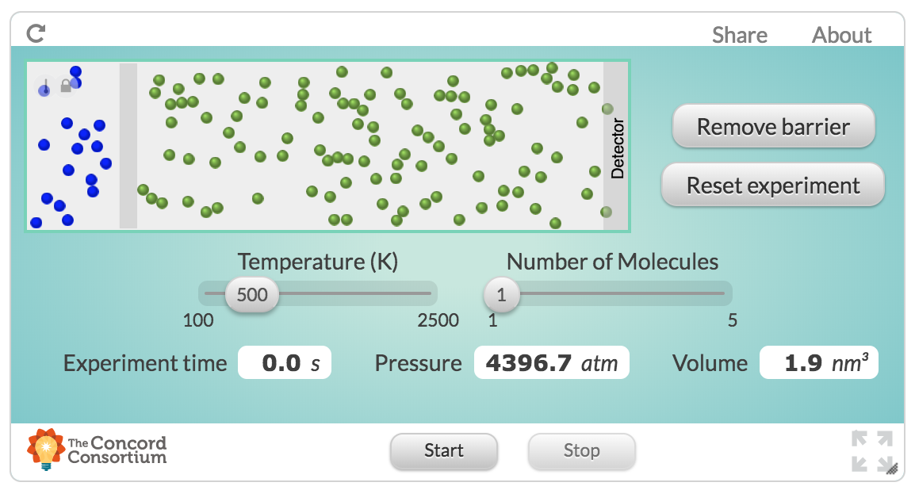
Example: Students’ use of simulations
Introduction | Overview | Study 1 | Study 2 | Future Work
How can HS students use new sources of data as part of their science learning in online classes?
Design a simulation and activities focused on work with data
Students were able to wrangle and model complex data
Rosenberg, 2017, MVLRI RPIN

Slide 14

Example: Engaging in scientific practices
Introduction | Overview | Study 1 | Study 2 | Future Work
How do MS students engage in modeling and explanation as described in the NGSS?
Study students’ epistemic considerations about scientific practices using manual and automated (NLP) approaches
Students’ developed understanding of generality
Rosenberg & Krist, 2016, April, NARST; Krist & Rosenberg, 2016, July, ICLS; Rosenberg & Schwarz, 2016, April, NARST
Notes:
Introduction to this - engaging in scientific practices

Slide 15
Questions about teachers’ support for work with data
Introduction | Overview | Study 1 | Study 2 | Future Work
Students’ Work With Data
Teachers’ Support for Work With Data
Design and development of contexts for work with data
Curricular standards,
resources,
assessments,
and technological tools
Notes:
As you can see, I have a lot of questions and interests about the use of data in science education research, teaching, and learning. I obviously can’t talk about all of these questions today, but I will,
Touch on some of them briefly,
And later, I’ll go into some considerable depth on one of them.

Slide 16
Questions about teachers’ support for work with data
Introduction | Overview | Study 1 | Study 2 | Future Work
How can teachers support student work with data?
What aspects of work with data can teachers and teacher educators leverage to support engagement in ambitious practices?
How do teachers with mathematics backgrounds differ in their ability to engage students in work with data?

Slide 17
Example: Teachers’ data modeling
Introduction | Overview | Study 1 | Study 2 | Future Work
How do teachers from different backgrounds develop capabilities to work with data?
Support in-service teachers’ to work with data
Found that open-ended work with data was productive and led to rich discussions around students’ use of data
Rosenberg & Henriksen, in preparation

Slide 18
Example: Teachers’ uses of scientific modeling
Introduction | Overview | Study 1 | Study 2 | Future Work
How did two in-service MS teachers’ practice and views change over a long period of time?
Explored how teachers take up the pedagogical practice of scientific modeling
A focus on students sharing their ideas aligned with modeling and provided focus
“Once you get them to share those ideas, the coolest part is seeing . . . them adapt and evolve those into a better understanding of what's really going on.”
“A lot of my kids certainly still hold misconceptions, but they got rocked, too, because of the different models that we used.”
Rosenberg, Schwarz, & Akcaoglu, revise and resubmit, JTE; Rosenberg, Schwarz, Lee, & Akcaoglu, 2015, NARST
Notes:
modeling: explaining phenomena by iteratively constructing, evaluating, and revising models
models: “specialized representations that simplify systems…to illustrate, explain, and predict phenomena”
(Schwarz et al., 2009, p. 634)

Slide 19
Research focused on work with data
Introduction | Overview | Study 1 | Study 2 | Future Work
Students’ Work With Data
Teachers’ Support for Work With Data
Curricular standards,
resources,
assessments,
and technological tools
Design and development of contexts for work with data
Notes:
As you can see, I have a lot of questions and interests about the use of data in science education research, teaching, and learning. I obviously can’t talk about all of these questions today, but I will,
Touch on some of them briefly,
And later, I’ll go into some considerable depth on one of them.

Slide 20
Researchers studying work with data
Introduction | Overview | Study 1 | Study 2 | Future Work
How can researchers study engagement in scientific and engineering practices?
How can researchers study authentic artifacts created by teachers and students?
What contexts are needed to support work with data?

Slide 21
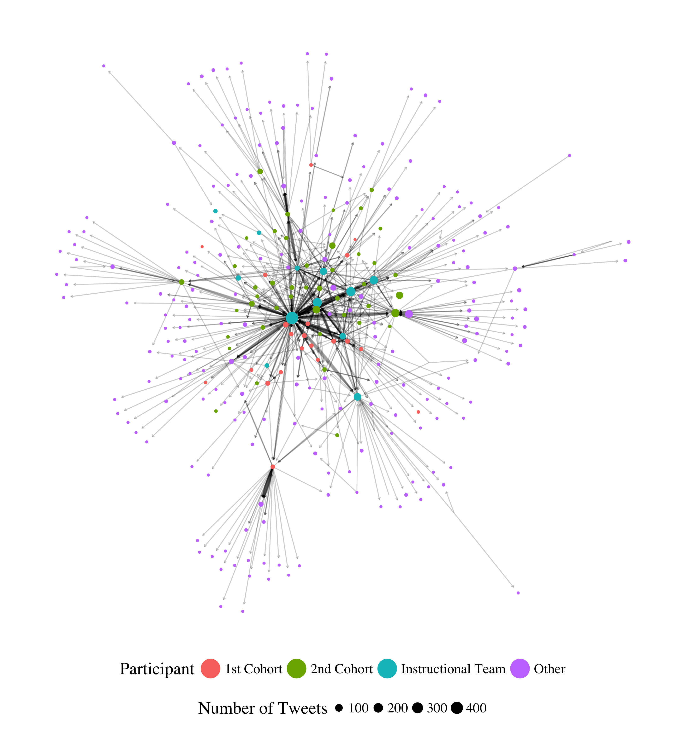
Example: Development of communities on Twitter
Introduction | Overview | Study 1 | Study 2 | Future Work
What can digital sources of information tell us about teaching and learning in Professional Learning Networks?
Studied development of community in a graduate certificate program in Urban STEM across educational and communication technologies (i.e., Twitter)
Examine the types of interactions community members have, and how to portray those connections between members
Rosenberg, Greenhalgh, Wolf, & Koehler, 2017, JCMST; Rosenberg, Greenhalgh, Wolf, & Koehler, 2016, AECT

Slide 22

Example: Analysis of teachers’ TPACK using performance assessments
Introduction | Overview | Study 1 | Study 2 | Future Work
How can researchers study artifacts created by teachers in MA in Education and MA in Educational Technology programs?
Assessed teachers’ knowledge through digital portfolios as performance assessments of teachers’ Technological Pedagogical Content Knowledge (TPACK)
Found that portfolios could be used to understand teachers’ TPACK and its differences across programs
Koehler, Greenhalgh, Rosenberg, & Keenan, 2016, JTATE; Rosenberg, Greenhalgh, & Koehler, 2015, SITE Proceedings

Slide 23
How do K-12 students who work with data in science education engage in their learning?
Introduction | Overview | Study 1 | Study 2 | Future Work
Two studies to explore this issue:
How do learning activities and being able to choose impact student engagement in high school science classrooms?
How does work with data impact student engagement in STEM in summer STEM programs?
Overview
Notes:
Back to model
summer STEM programs

Slide 24

Work with data
Introduction | Overview | Study 1 | Study 2 | Future Work

Slide 25
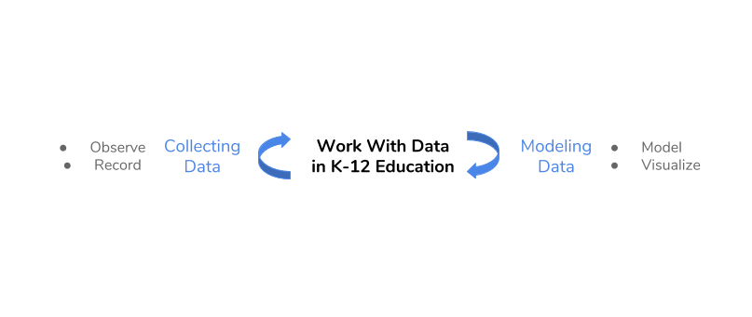
Work with data
Introduction | Overview | Study 1 | Study 2 | Future Work

Slide 26
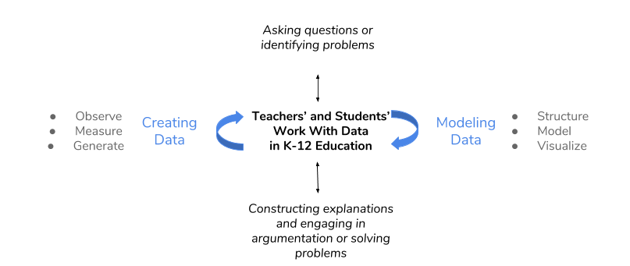
Work with data
Introduction | Overview | Study 1 | Study 2 | Future Work
Hancock, Kaput, & Goldsmith, 1992; Wild & Pfannkuch, 1999
NGSS Lead States, 2013; National Research Council, 2012

Slide 27
Introduction | Overview | Study 1 | Study 2 | Future Work
Introduction
Overview
Study 1
Study 2
Future Work

Slide 28
STUDY ONE
Introduction | Overview | Study 1 | Study 2 | Future Work
Explored common and hands-on science, activities using a person-in-context approach
Mixture of inquiry-based (or scientific practices-based) teaching and learning as well as common school activities (lecture, individual work)
Schmidt, Rosenberg, & Beymer, 2018, JRST
Notes:
maybe hedge

Slide 29
Context and sample
Introduction | Overview | Study 1 | Study 2 | Future Work
12 high school classrooms
Large high school outside of a large metropolitan area
244 students
From racially and ethnically diverse groups (42% Hispanic, 37% White, 12% Black, 9% Multi-racial and from other groups)
Notes:
LARGE!

Slide 30
Research question
Introduction | Overview | Study 1 | Study 2 | Future Work
How do learning activities and being able to choose impact students’ engagement in science?
Notes:
Demonstrate how data can be used to empower teachers and students.
What role this play

Slide 31
Experience sampling method (ESM)
Introduction | Overview | Study 1 | Study 2 | Future Work
Involves asking participating students / youth about their experiences using short surveys
Typically using a mobile device (app on a phone)
Every 15-30 minutes
“When you were signaled, how interested were you in what you were learning?”
Notes:
time to comlete

Slide 32
Why ESM?
Introduction | Overview | Study 1 | Study 2 | Future Work
Understand learning experiences in a qualitatively distinct way (Hektner, Schmidt, & Csikszentmihalyi, 2007)
Helps us to understand moment-to-moment changes in learning
Understand experiences during activities such as laboratories
Can investigate engagement in learning activities in a context-sensitive way
Notes:
I know this past research is a stretch – I would like to keep this just for the moment :)
Importance (but under-emphasis on) context in research on teacher knowledge (Rosenberg & Koehler, 2015)
Role of context in explaining processes around teaching and learning with technology (Phillips, Koehler, & Rosenberg, 2016)

Slide 33
Dimensions of engagement
Introduction | Overview | Study 1 | Study 2 | Future Work
Cognitive engagement: Importance to self
Affective engagement: Enjoyment of activity
Behavioral engagement: Effort exerted
Notes:
Psychological and motivational investment in learning activities

Slide 34
Person-oriented approach
Introduction | Overview | Study 1 | Study 2 | Future Work
How aspects of engagement are experience together and at once in learners’ experiences
Interpreted solutions on the basis of fit indices, cross-validation, and concerns of parsimony and interpretability
Two-step cluster analysis via prcr (Rosenberg, Schmidt, Beymer, & Steingut, 2018)
Notes:
experience
solutions
six

Slide 35
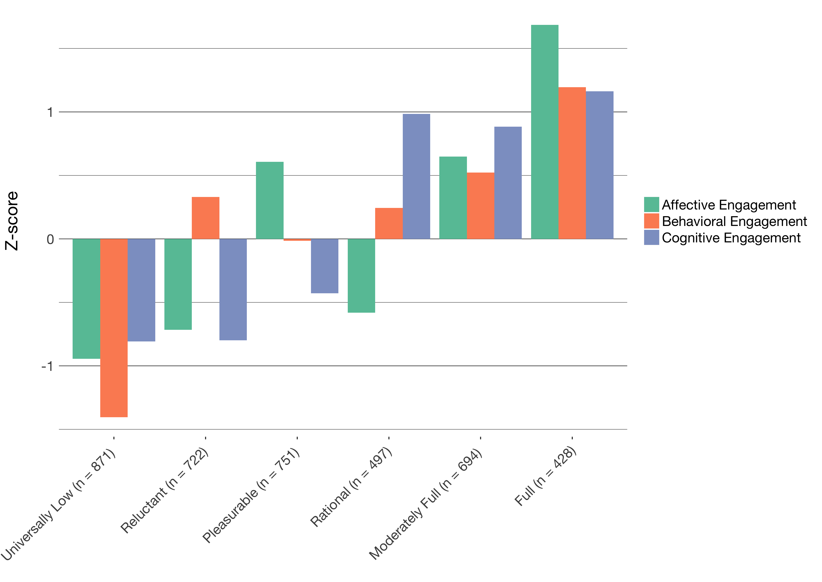
Profiles of engagement
Introduction | Overview | Study 1 | Study 2 | Future Work

Slide 36
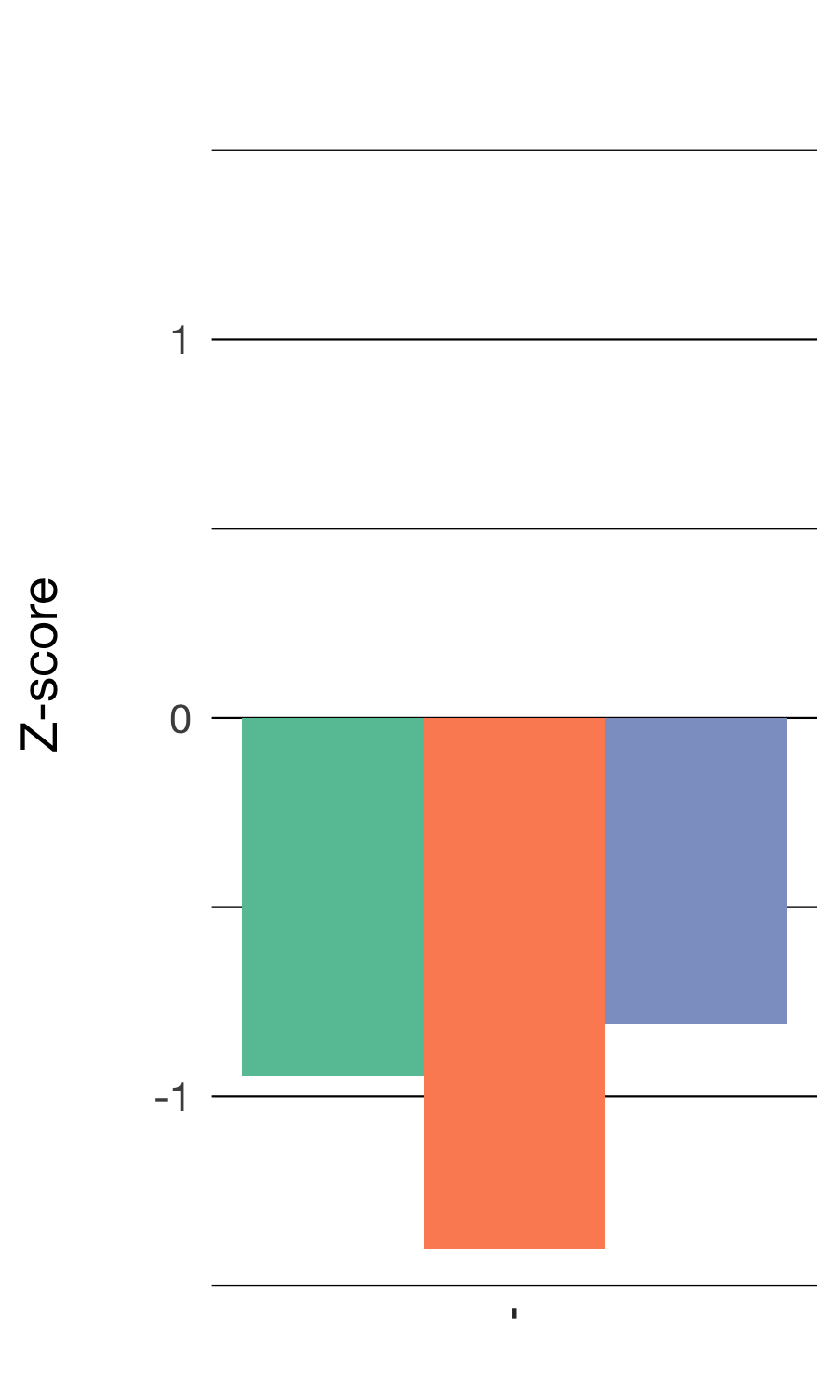
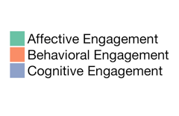
Universally Low
Introduction | Overview | Study 1 | Study 2 | Future Work
Low levels of all three dimensions of engagement
871 responses

Slide 37
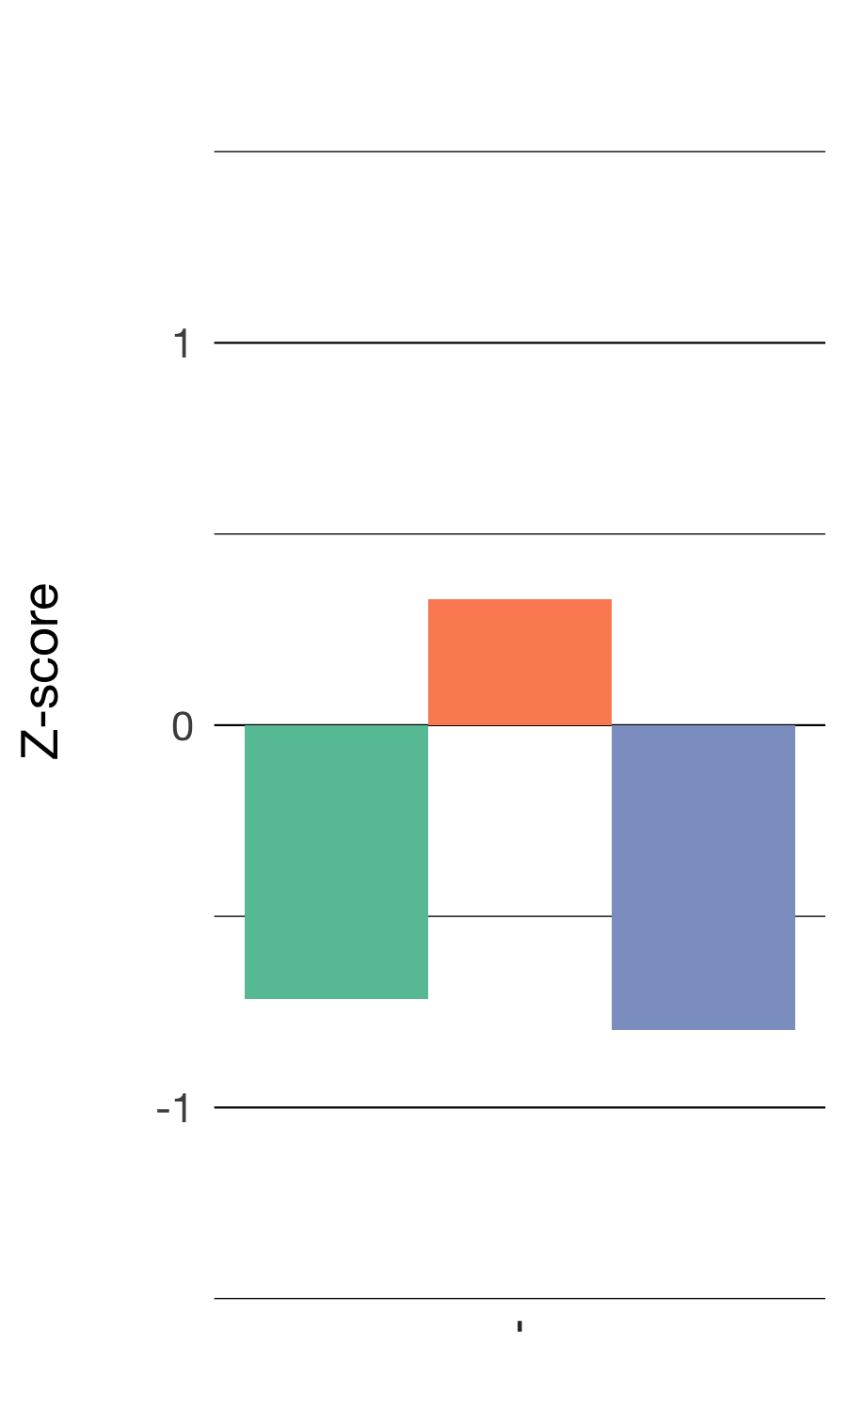
Reluctant
Introduction | Overview | Study 1 | Study 2 | Future Work
Modest levels of effort paired with low enjoyment and importance
722 responses

Slide 38
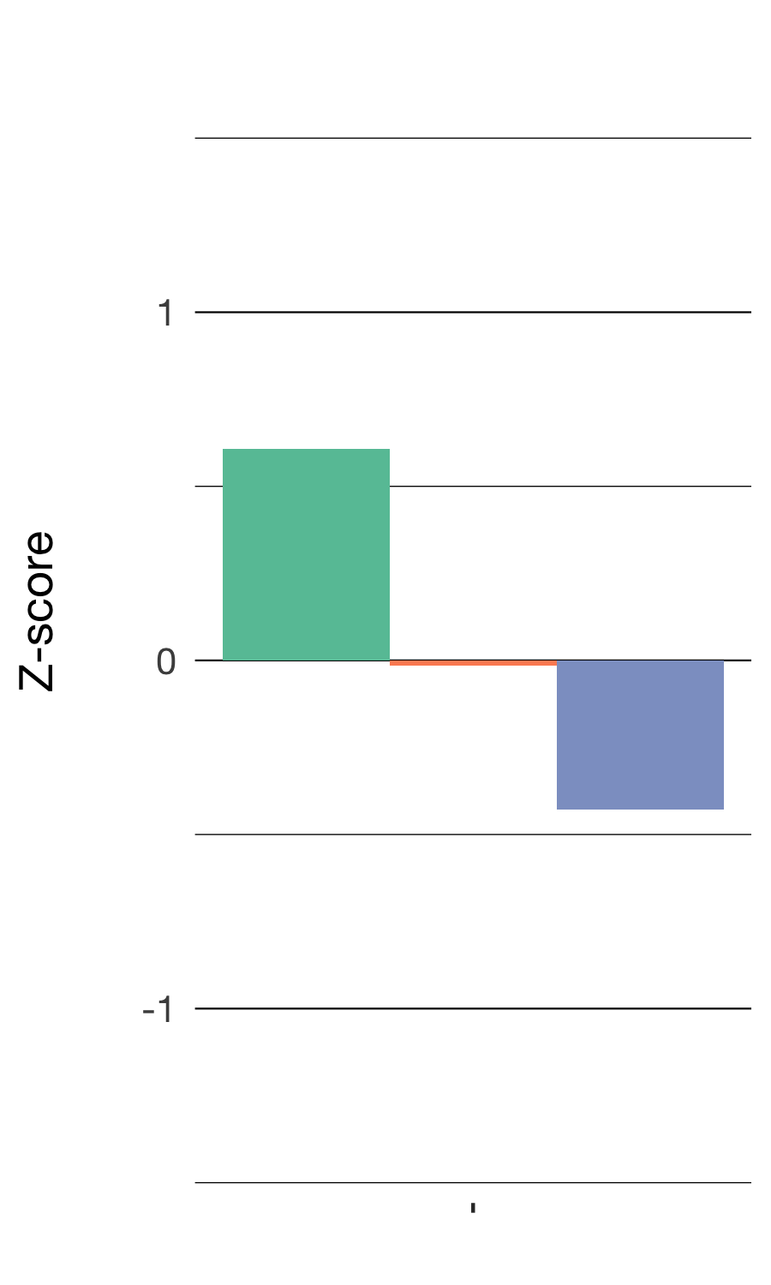
Pleasurable
Introduction | Overview | Study 1 | Study 2 | Future Work
High enjoyment with low importance
751 responses

Slide 39
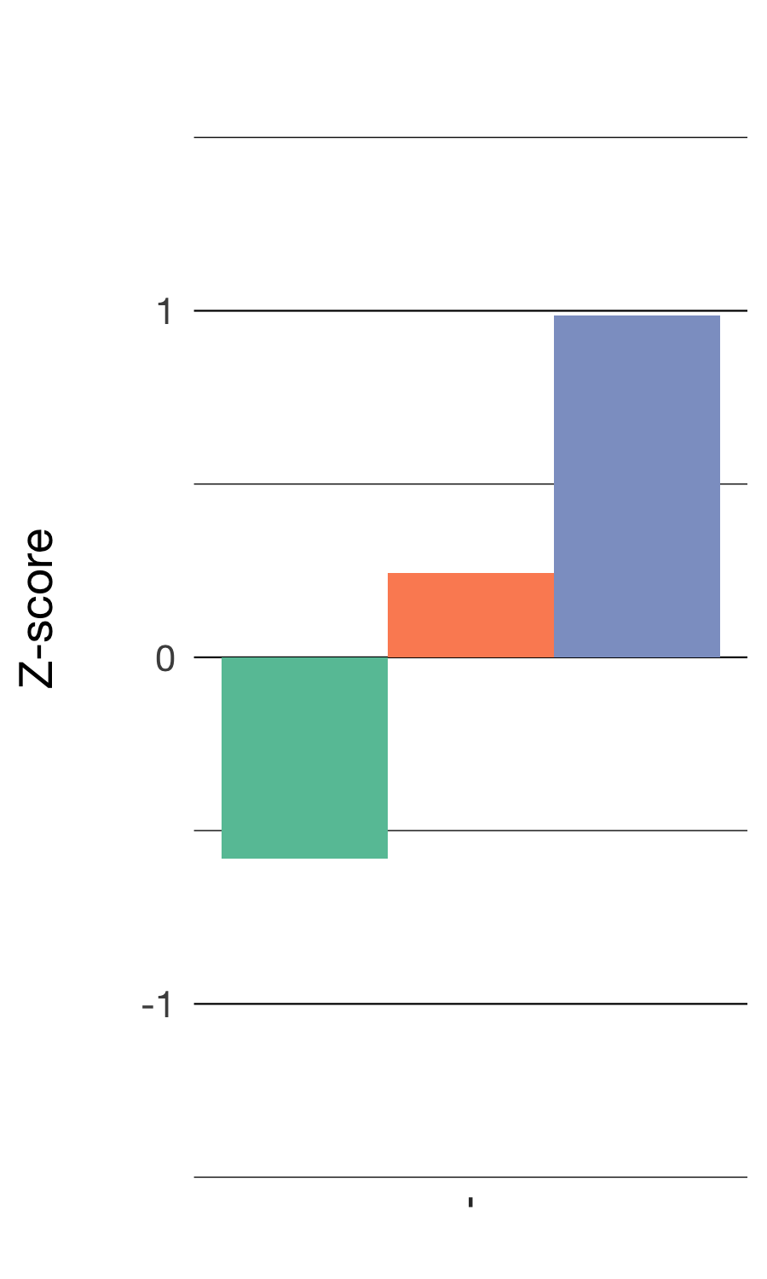
Rational
Introduction | Overview | Study 1 | Study 2 | Future Work
High importance, moderate effort, and low enjoyment
491 responses

Slide 40
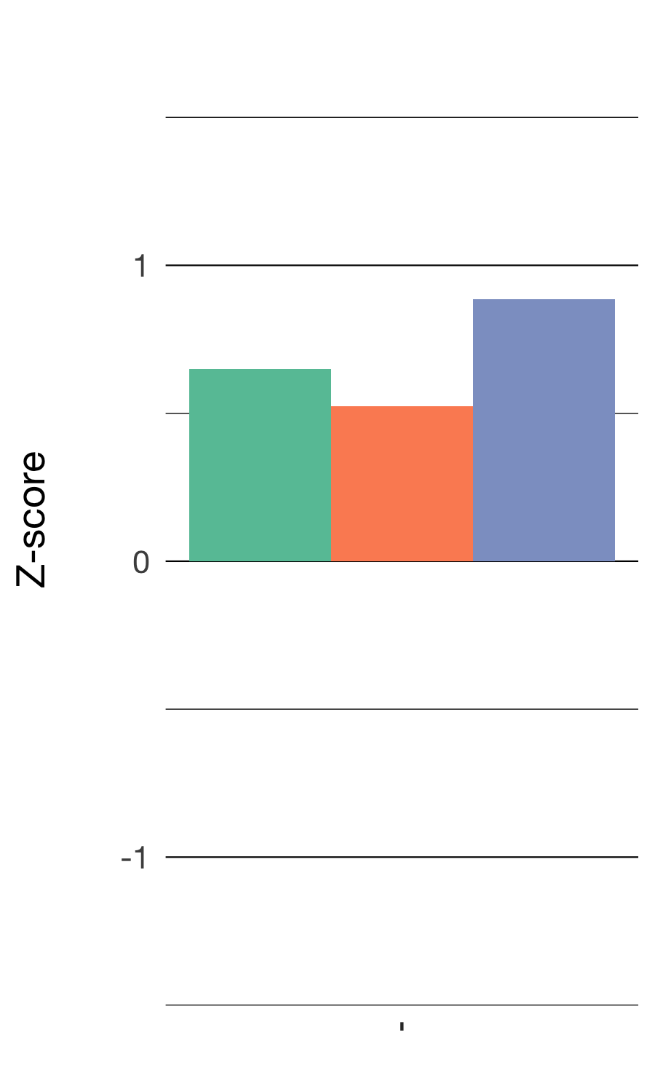
Moderately Full
Introduction | Overview | Study 1 | Study 2 | Future Work
Moderately high enjoyment, effort, and importance
694 responses

Slide 41
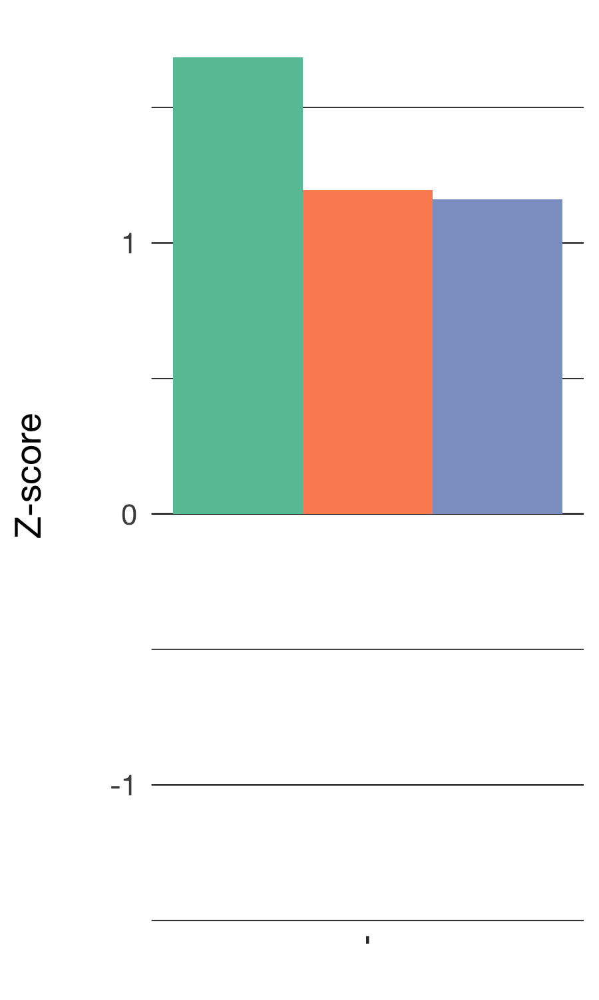
Full
Introduction | Overview | Study 1 | Study 2 | Future Work
High enjoyment, effort, and importance
428 responses

Slide 42
Profiles of engagement
Introduction | Overview | Study 1 | Study 2 | Future Work

Slide 43
Different activities are associated with different profiles of engagement
Introduction | Overview | Study 1 | Study 2 | Future Work
Laboratory activities can be particularly engaging (and disengaging; Z = 3.93, p < .05; Z = 3.62, p < .05)
Quizzes and tests have some affordances in terms of students’ engagement (Rational: Z = 12.62, p < .05)
Individual work can be particularly disengaging (Reluctant; Z = 3.72, p < .05)
χ² = 339.16 (20), p < .001
Notes:
mention three points

Slide 44
The impacts of choice on engagement
Introduction | Overview | Study 1 | Study 2 | Future Work
Being able to choose who to work with is associated with Universally Low engagement (β = 1.43, p < .001)
Choosing how to do an activity is associated with Full engagement (β = 1.35, p < .05)
Defining the topic or purpose is associated with Full engagement (β = 1.60, p < .001) and less Universally Low engagement (β = 0.44, p < .05)

Slide 45
Summary
Introduction | Overview | Study 1 | Study 2 | Future Work
Using the right kind of data, ESM, allowed us to study the impacts of the learning activity and choice when students work with data
Different activities in science are associated with different profiles of engagement
Providing chances for students to decide what to do or how to do it also impacts their engagement
Notes:
work with data - maye define as

Slide 46
Implications for teachers
Introduction | Overview | Study 1 | Study 2 | Future Work
Prepare teachers to carry out a range of activities, but with an emphasis on engaging laboratory activities
Help teachers recognize different choices in teacher preparation coursework
Notes:
Laboratory activities in science can be highly engaging
Choice—especially related to how students do laboratory activities and who determines how the activities is framed (choosing the purpose or topic)—is a key factor affecting how engaging laboratory activities are
Person-in-context approach helped us to characterize distinct profiles of engagement

Slide 47
Introduction | Overview | Study 1 | Study 2 | Future Work
Introduction
Overview
Study 1
Study 2
Future Work

Slide 48
STUDY 2
Introduction | Overview | Study 1 | Study 2 | Future Work
Studied work with data in summer STEM programs using profiles of engagement and its conditions
Focus specifically on work with data as capabilities that cut across STEM content areas
Context of summer STEM programs designed around best practices

Slide 49
Context and sample
Introduction | Overview | Study 1 | Study 2 | Future Work
Nine summer STEM programs
Offered by two intermediary organizations responsible for coordinating programs and their curricula
203 students
From racially and ethnically diverse groups (48% Hispanic, 36% Black, 7% Asian / Pacific Islander, 6% White, 3% Multi-racial)
Notes:
From socioeconomically diverse groups (79% Parent Education HS level or below)

Slide 50
Research question
Introduction | Overview | Study 1 | Study 2 | Future Work
How does doing data practices (e.g., collecting, analyzing, interpreting, etc.) impact students’ engagement?
Notes:
data practice

Slide 51
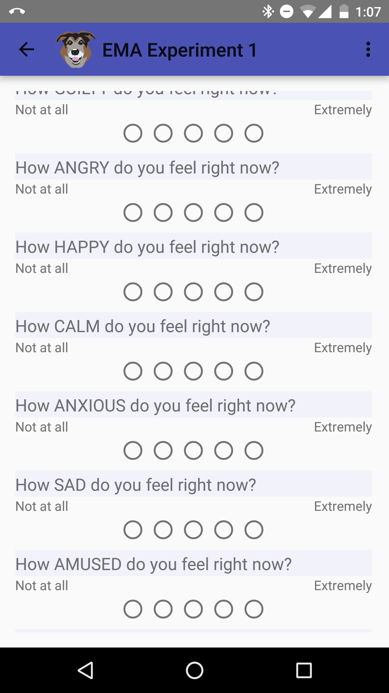
Experience sampling method (ESM)
Introduction | Overview | Study 1 | Study 2 | Future Work
Notes:
Like the previous study, the data we used to answer this question was ESM.

Slide 52
Coding frame for data practices
Introduction | Overview | Study 1 | Study 2 | Future Work
Data Practice | Description
Asking questions or defining problems | Discussing and exploring topics to investigate and pose questions.
Making observations | Watching and noticing what is happening with respect to the phenomena or problem being investigated.
Generating data | Figuring out how or why to record an observation as data and generating coding frames or measurement tools.
Data modeling | Understanding and explaining phenomena using models of the data that account for variability or uncertainty.
Interpreting and communicating findings | Discussing and sharing and presenting findings.
Notes:
shorten

Slide 53
Engagement and its conditions
Introduction | Overview | Study 1 | Study 2 | Future Work
Cognitive engagement: Learned something new
Affective engagement: Enjoyment of activity
Behavioral engagement: Effort exerted
Challenge: Perceptions of how challenging the activity was
Competence: Perceptions of how good at an activity one was
Notes:
define this better

Slide 54
Constructing profiles
Introduction | Overview | Study 1 | Study 2 | Future Work
How aspects of engagement and its conditions are experience together and at once
Interpreted solutions on the basis of fit indices, cross-validation, and concerns of interpretability and parsimony
Use of latent profile analysis
Notes:
Measures:
ESM self-reports for cognitive, behavioral, and affective and perceptions of challenge and competence
Video-recordings of activities
Pre-program measures of interest

Slide 55
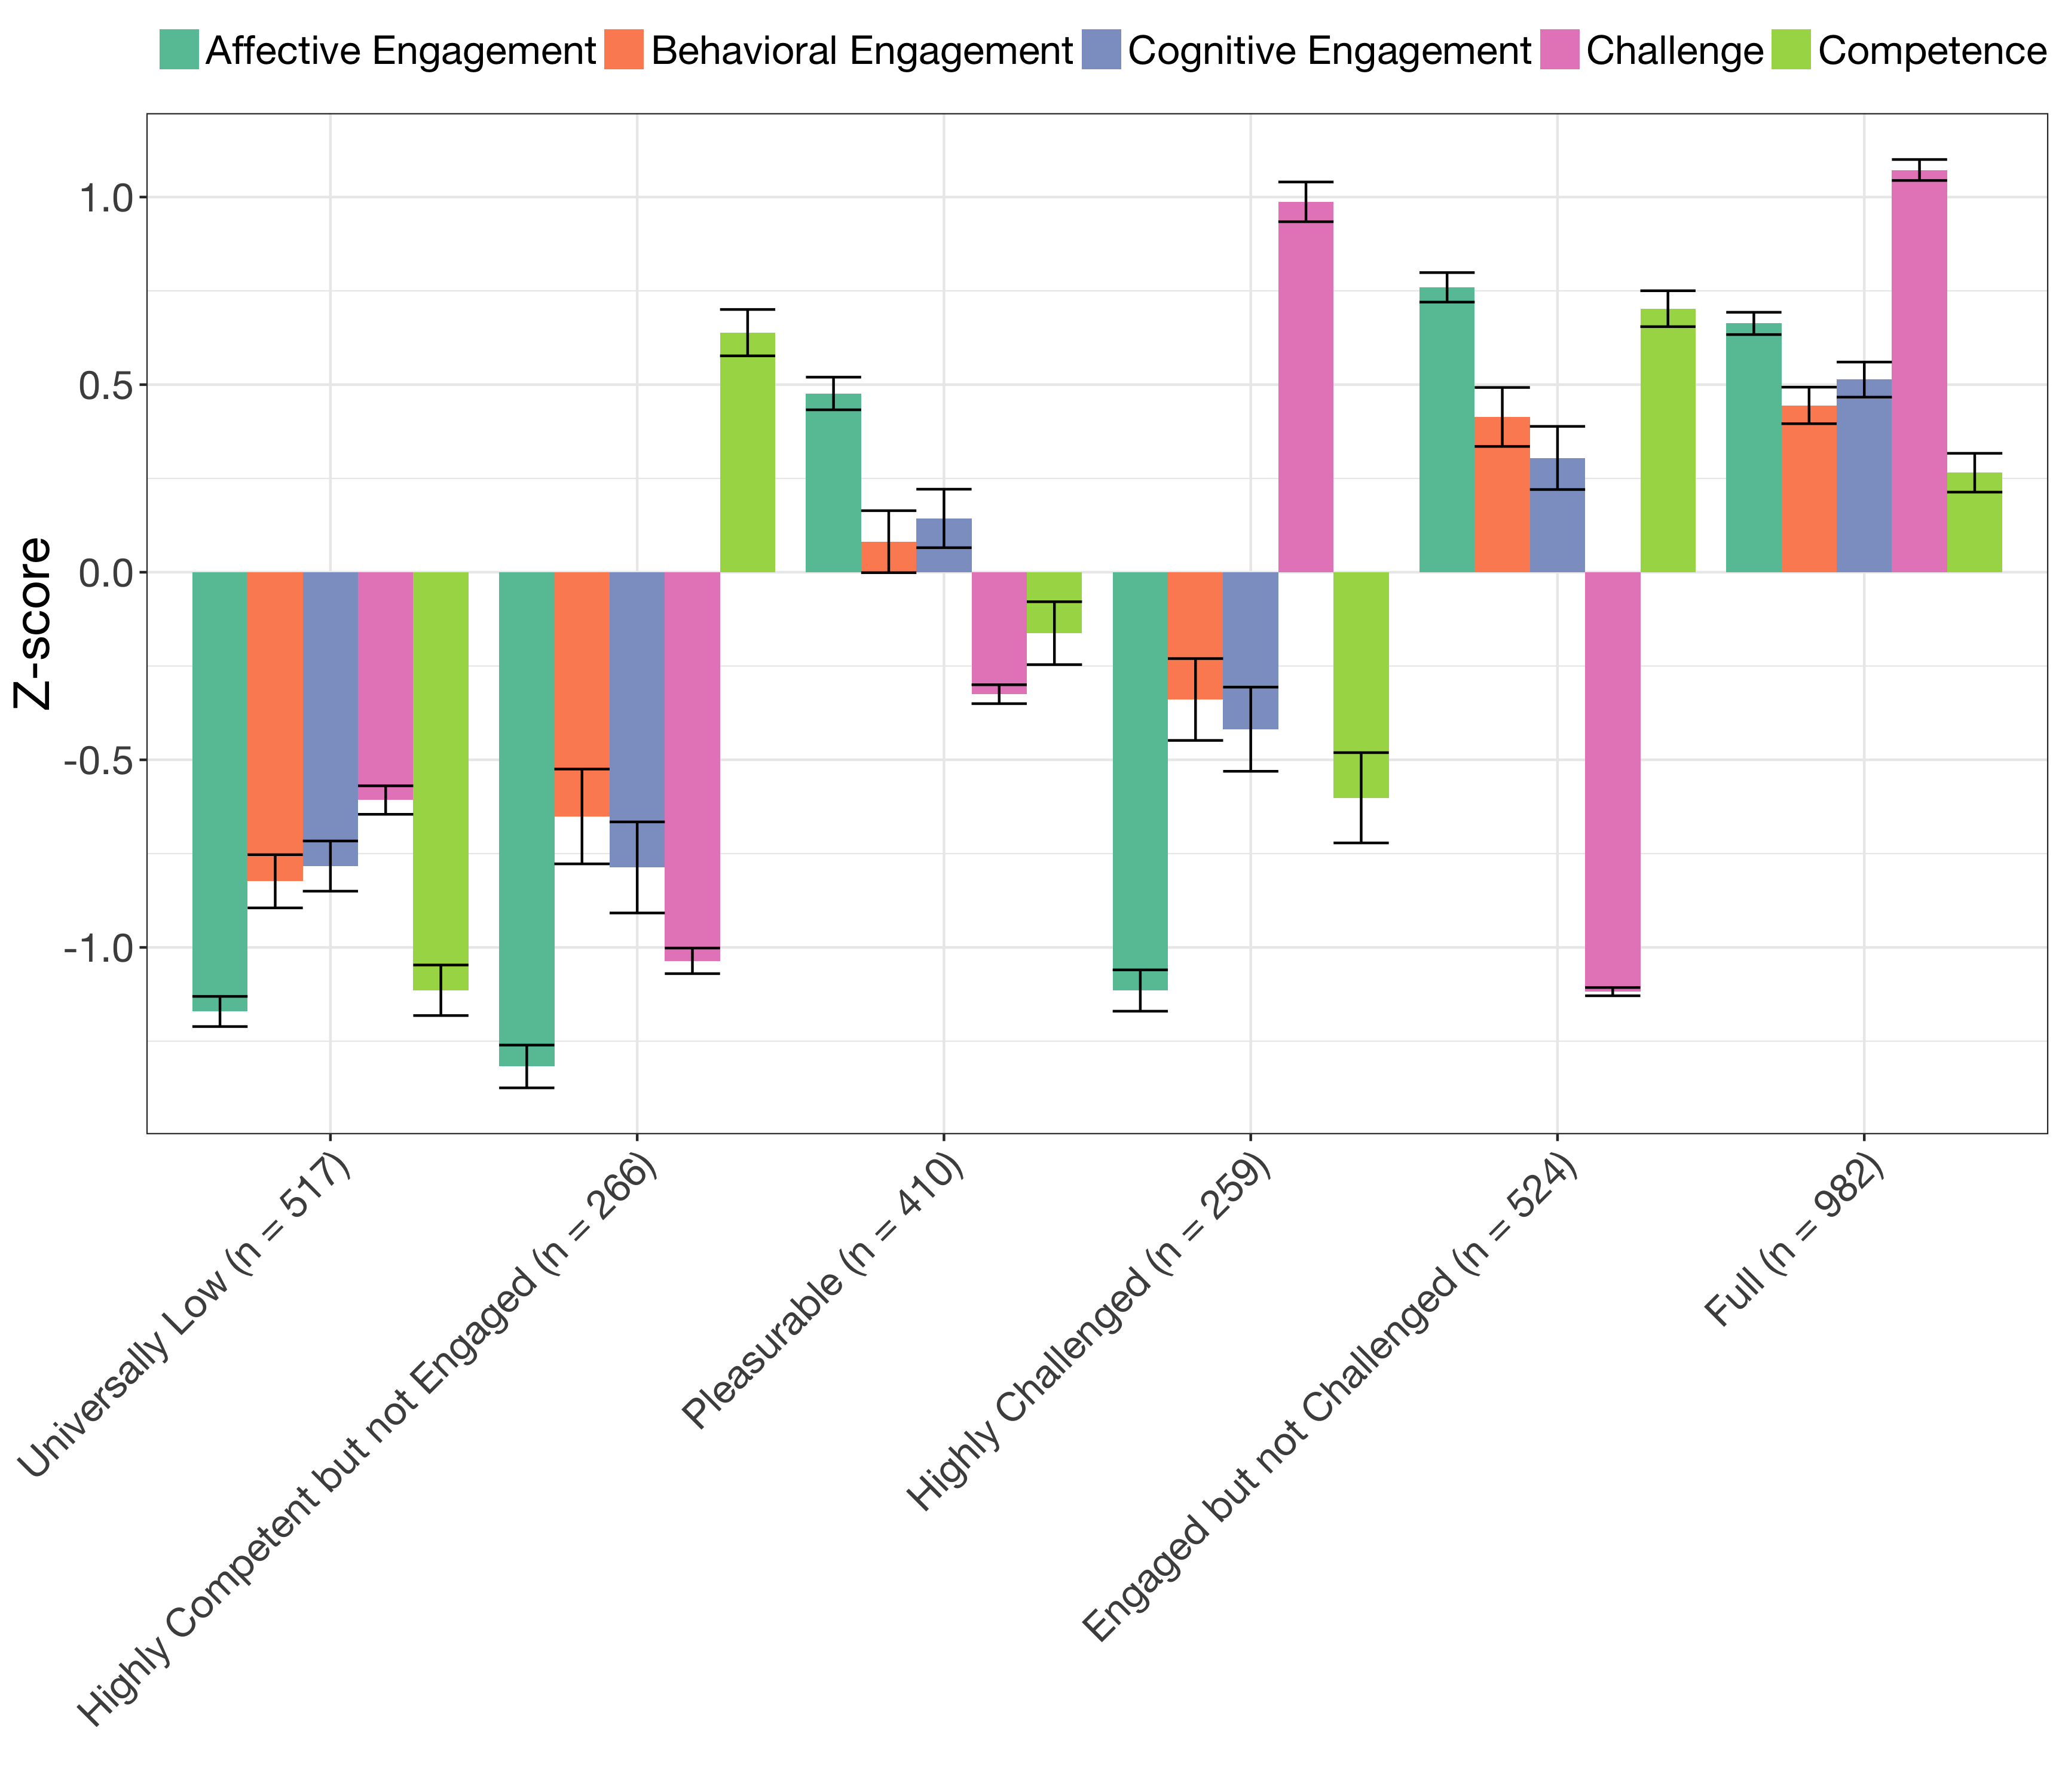
Profiles of engagement and its conditions
Introduction | Overview | Study 1 | Study 2 | Future Work
Notes:
Do whatever you did in Study one to present these profiles. (Breaking into 6 slides, and 7th that puts them back together)

Slide 56
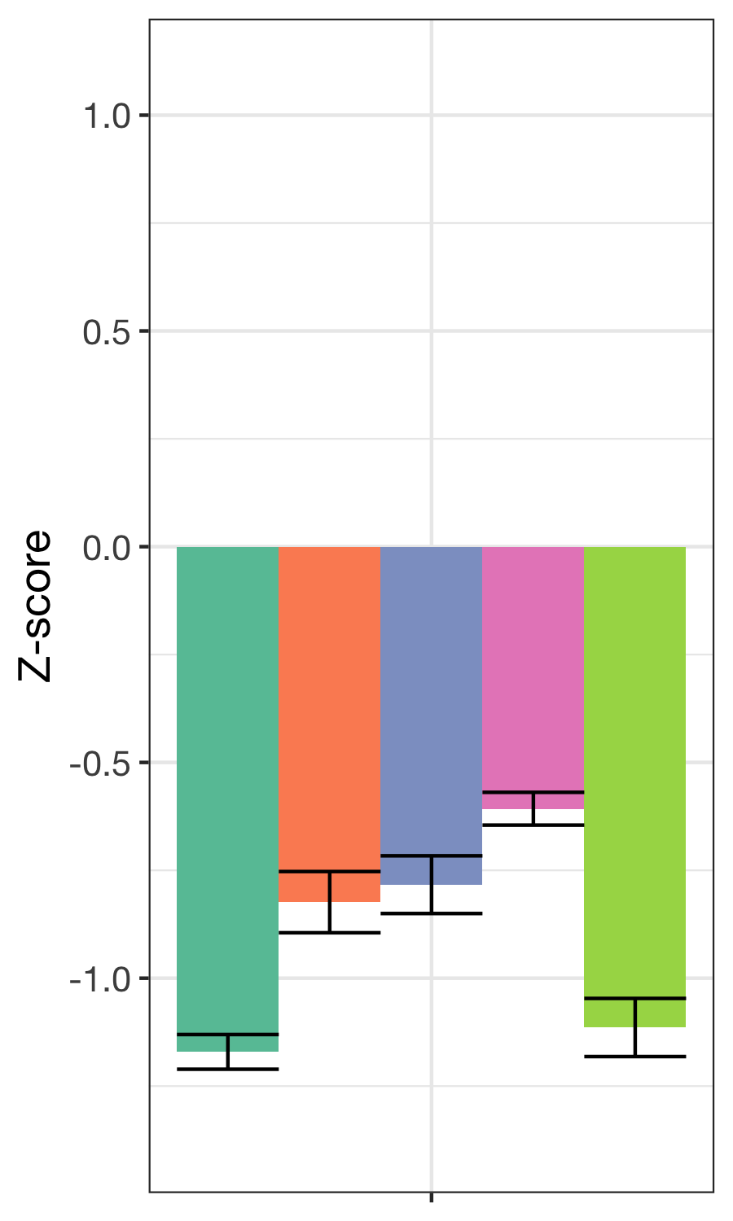
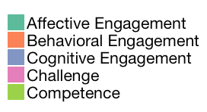
Universally low
Introduction | Overview | Study 1 | Study 2 | Future Work
Low levels of engagement and its conditions
571 responses

Slide 57
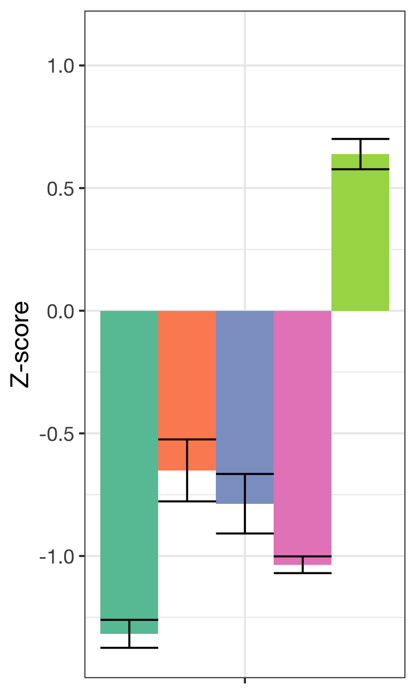
Highly competent but not engaged
Introduction | Overview | Study 1 | Study 2 | Future Work
High competence, low engagement and challenge
266 responses

Slide 58
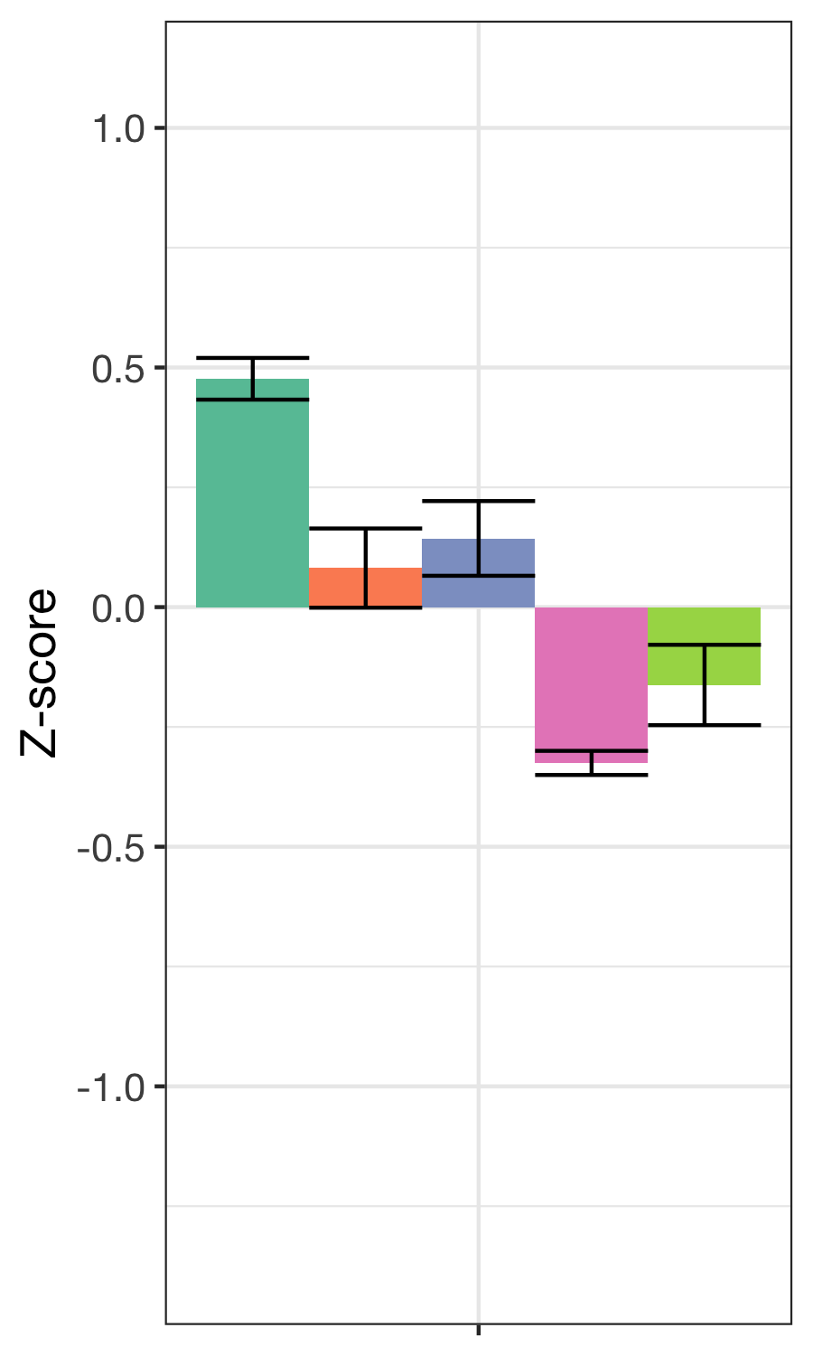
Pleasurable
Introduction | Overview | Study 1 | Study 2 | Future Work
Moderately high enjoyment, moderate effort and learning, and moderately low challenge and competence
410 responses

Slide 59
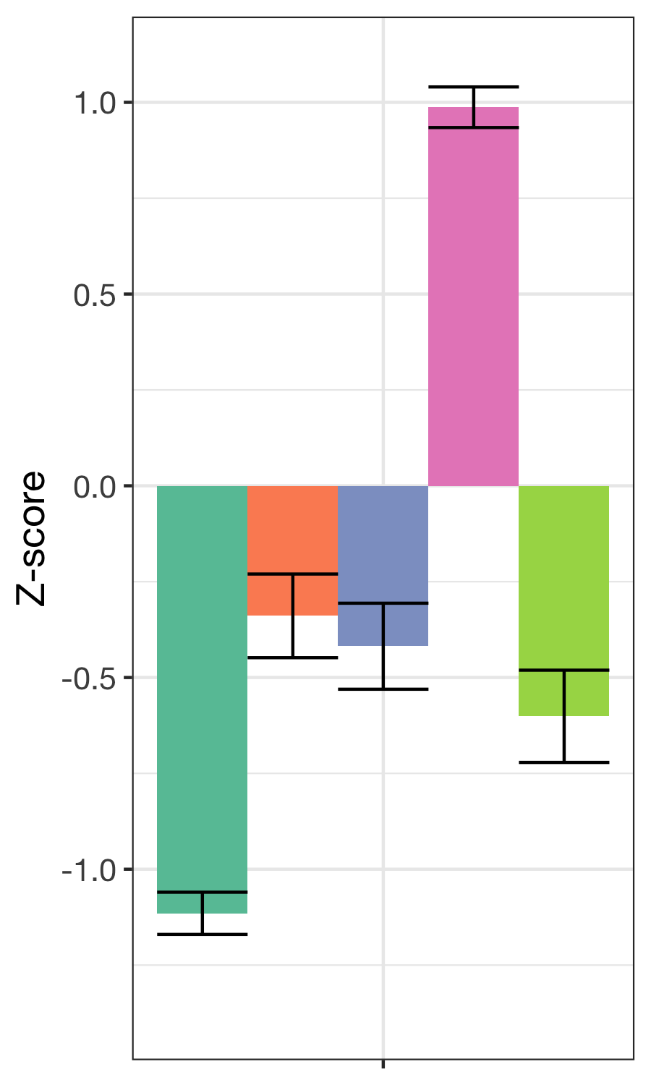
Highly challenged and disengaged
Introduction | Overview | Study 1 | Study 2 | Future Work
High challenge, low enjoyment, moderately low effort and learning, and low competence
259 responses

Slide 60
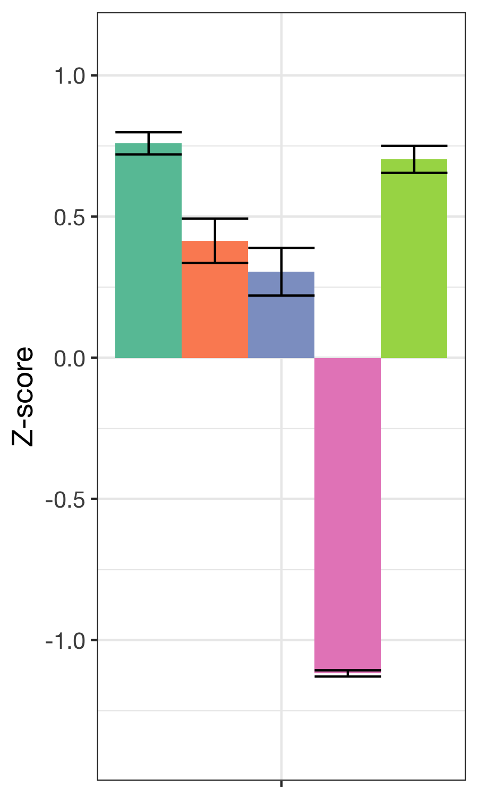
Engaged but not challenged
Introduction | Overview | Study 1 | Study 2 | Future Work
High enjoyment, moderately high effort and learning, low challenge, and high competence
524 responses

Slide 61
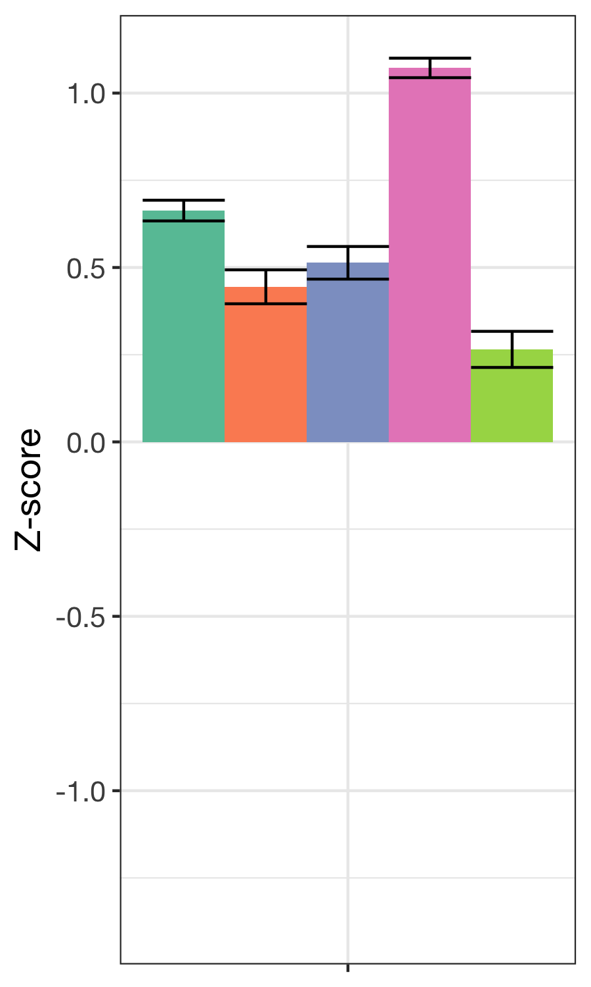
Full
Introduction | Overview | Study 1 | Study 2 | Future Work
High challenge and enjoyment and learning, moderate effort, and moderate competence
982 responses

Slide 62
Profiles of engagement and its conditions
Introduction | Overview | Study 1 | Study 2 | Future Work
Notes:
Do whatever you did in Study one to present these profiles. (Breaking into 6 slides, and 7th that puts them back together)

Slide 63
Quantitative findings: Engagement in data practices
Introduction | Overview | Study 1 | Study 2 | Future Work
Use of multi-level models (HLM) to analyze relations of work with data
When students report being Fully engaged:
When students are generating data relative to not working with data, they are more likely to be fully engaged (β = 1.395, p = .029) and less likely to be observing phenomena (β = 0.410, p = .028)
Notes:
REMAKE THIS GRAPH BY DATA PRACTICE

Slide 64
Qualitative findings: Engagement in data practices
Introduction | Overview | Study 1 | Study 2 | Future Work
Generating data not very common in ways envisioned in recent reform efforts; making observations is more frequent
Affordances of different subject areas for different aspects of work with data:
Making observations (science-focused programs)
Generating data (engineering-focused programs)
Analyzing data (mathematics-focused programs)
Models are frequently created by others (authoritative sources), instead of students
Notes:
6 profiles, model 2, estimated in Mplus via tidyLPA
Change the order of the clustered variables
Need to name the profiles

Slide 65
Summary
Introduction | Overview | Study 1 | Study 2 | Future Work
ESM helped us understand how specific activities, such as generating data, relate to work with data engage learners
Difficulty linking data creation to data modeling as part of one investigation
Summer STEM programs have affordances and constraints for work with data
Notes:
Combine the three previous slides into to two. Make clear statements that will impress the audience. Aim to impress a 12th grader.

Slide 66
Implications for teachers
Introduction | Overview | Study 1 | Study 2 | Future Work
Generating data is an important and engaging step in work with data because it involves students in making the work real
Inscriptions serve commitments
Fostering a complete cycle of investigation is difficult
Modeling data is not very common
Notes:
Combine the three previous slides into to two. Make clear statements that will impress the audience. Aim to impress a 12th grader.

Slide 67
Findings from across both studies
Introduction | Overview | Study 1 | Study 2 | Future Work
As students move from activity to activity, their engagement can change
Engagement seems to be different when we consider its conditions (challenge competence)
Engagement seems to be different across context (high school classrooms and summer STEM programs)

Slide 68
Introduction | Overview | Study 1 | Study 2 | Future Work
Introduction
Overview
Study 1
Study 2
Future Work

Slide 69
Research focused on work with data
Introduction | Overview | Study 1 | Study 2 | Future Work
Researchers’ design and development of contexts for work with data
Students’ Work With Data
Teachers’ Support for Work With Data
Curricular standards,
resources,
assessments,
and technological tools
Notes:
As you can see, I have a lot of questions and interests about the use of data in science education research, teaching, and learning. I obviously can’t talk about all of these questions today, but I will,
Touch on some of them briefly,
And later, I’ll go into some considerable depth on one of them.

Slide 70
FUTURE WORK
Introduction | Overview | Study 1 | Study 2 | Future Work
Students’ work with data:
Building students’ interest, future plans, and learning
Doing data science
Teachers’ support for work with data:
Helping teachers to do work with data
Building STEM leadership through networks

Slide 71
Students’ work with data: Changes in students’ interest, future plans, and learning
Introduction | Overview | Study 1 | Study 2 | Future Work
How engaging in specific aspects of work with data lead to changes in interest and future plans (Beymer, Rosenberg & Schmidt, 2018, JYA)
How students develop and sustain capabilities that connect across the STEM (and school) curriculum
How work with data impact students’ conceptual understanding in science

Slide 72
Students’ work with data: Doing data science
Introduction | Overview | Study 1 | Study 2 | Future Work
Past studies were not in contexts not designed and developed to help teach students data science
Build on collaboration with Michigan Virtual School to design activities and tools to make it easier for students to use digital sources of data
Partner with faculty across departments at UTK to support and document work with data at the post-secondary level
Potential for funding (NSF DRK-12 and I-TEST)

Slide 73
Future work: Helping teachers to do work with data
Introduction | Overview | Study 1 | Study 2 | Future Work
Teachers find the shift toward more open-ended work with data to be challenging
Engage pre-service and in-service teachers in coursework and opportunities to engage in work with data, particularly with computational tools
Opportunities to involve teachers in design and development of technological tools (i.e., support TPACK) as a way to bridge educational technology with content areas in methods courses
Potential for collaborative work across TPTE and teacher preparation coursework
Notes:
Explore how work with in mathematics and engineering classes allows learners to more deeply engage in science as part of a positive “feedback loop”

Slide 74
Collaborative work across TPTE and teacher preparation coursework
Introduction | Overview | Study 1 | Study 2 | Future Work
Engage pre-service and in-service teachers and students at the graduate levels levels in opportunities to engage in work with data:
Science teaching methods courses
Courses in simulation and modeling
Courses in creation of data products
Opportunities to involve teachers in design and development of technological tools (i.e., support TPACK) as a way to bridge educational technology with content areas in methods courses
Educational technology
VolsTeach
Courses in the Education minors
Notes:
Explore how work with in mathematics and engineering classes allows learners to more deeply engage in science as part of a positive “feedback loop”

Slide 75
Teachers’ support for work with data: Building STEM leadership through networks
Introduction | Overview | Study 1 | Study 2 | Future Work
Work across content areas in educational technology, science education, and mathematics education teacher preparation coursework
Build teachers and administrators purposeful uses of educational technology (i.e., simulation, work with data)
Work with teachers in Knox County Schools focused around online (i.e., social media) and face-to-face PLNs
STEM “Integration” vs. “Positive Feedback Loops” in STEM
Potential for funding (Gates Foundation) and research-practices partnerships
Notes:
Collaborator and leader in ed tech, science ed, and STEM ed
Leadership
Online
Mention that you did teach – HS level
Things
My work with teachers will inform my methods classes

Slide 76

Introduction | Overview | Study 1 | Study 2 | Future Work
Thank you to participating teachers and students and to collaborators!
Joshua Rosenberg jrosen@msu.edu
http://jmichaelrosenberg.com
@jrosenberg6432
Michigan State University
Notes:
Demonstrate how data can be used to empower teachers and students.

Slide 77
References
Introduction | Overview | Study 1 | Study 2 | Future Work
Berland & McNeil, 2017
Lehrer & Schauble, 2015
Cobb et al., 2003
NGSS Lead States, 2015
National Research Council, 2012
Rosenberg et al., 2016
Koehler et al., 2016
Schmidt, Rosenberg, & Beymer, 2018
Beymer, Rosenberg, & Schmidt, 2018
Hancock, Kaput, & Goldsmith, 1992
Wild & Pfannkuch, 1999
Rosenberg et al., revise and resubmit
Rosenberg & Henriksen, in preparation
Rosenberg, Greenhalgh, Wolf, & Koehler, 2017, JCMST; Rosenberg, Greenhalgh, Wolf, & Koehler, 2016, AECT
3 NARST presentations
1 ICLS presentation
Notes:
Demonstrate how data can be used to empower teachers and students.

Slide 78
OTHER SLIDES

Slide 79
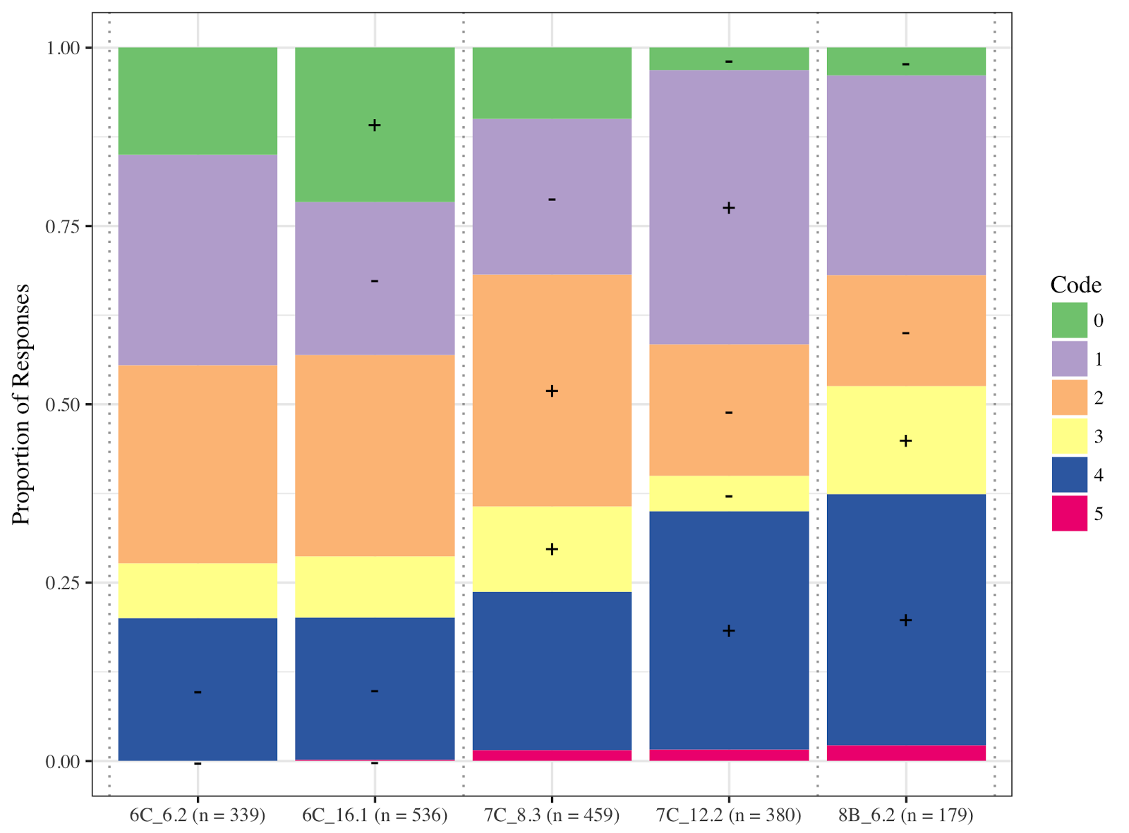
Change in generality

